Slide 1
Track A Dynamic Sparse Channel Via Differential Orthogonal Matching Pursuit
Presenter: Xudong Zhu
Authors: Xudong Zhu, etc.
Tsinghua University, Beijing, China
Notes:
Hi, everyone.
Since the author Xudong Zhu has some issue in China, so I will do this presentation for him.
The topic is about tracking a dynamic sparse channel via differential OMP.

Slide 2
Introduction
Channel state information (CSI)
Training sequences are usually utilized for channel estimation
Overhead of training sequences reduces spectrum efficiency
Compressive sensing (CS)
CS is able to recover channel from much less measurements
CS can be utilized to reduce the length of training sequences
Various CS algorithms
OMP: Orthogonal matching pursuit
CoSaMP: Compressive sampling matching pursuit
SOMP: Simultaneous OMP
……
Notes:
This slide is about introduction.
In most wireless communication systems, channel state information is very important.
Training sequences are usually utilized to for channel estimation.
And the spectrum efficiency loss is unavoidable due to the overhead of training sequences.
In recent years, compressive sensing technology has been widely adopted for channel estimation.
Accurate CSI can be recovered by CS technology based on reduced training sequences.
There are a lot of CS algorithms, the famous OMP, CoSaMP, and so on.

Slide 3
System Model
Dynamic channel recovery
$$y^{(t)}=Φ^{(t)}h^{(t)}+n^{(t)}, t=1,2,⋯,T,$$
$y^{(t)}={\left[y_{1}^{\left(t\right)},y_{2}^{\left(t\right)},⋯, y_{M}^{\left(t\right)}\right]}^{T}$ denotes the linear measurement;
$h^{(t)}={\left[h_{1}^{\left(t\right)},h_{2}^{\left(t\right)},⋯, h_{N}^{\left(t\right)}\right]}^{T}$ denotes the channel vector, $N>M$;
$Φ^{(t)}=Φ∈ℂ^{M×N}$ is a Toeplitz matrix based on $c={\left[c_{0},c_{1},⋯,c_{M}\right]}^{T}$;
$n^{(t)}∼CN\left(0,σ_{n}^{2}I_{M}\right).$
Notes:
The system model is very simple.
At each time slot, we have linear measurement y^(t) of the channel vector h^(t).
And we have a series of such measurements for different time slot.
Here, \Phi is sensing matrix, we assume it is the same one at all time slots.

Slide 4
Dynamic Channel Model
Dynamic channel
$$h_{i}^{(t)}=s_{i}^{(t)}a_{i}^{(t)}, 1≤t≤T,1≤i≤N,$$
$s_{i}^{(t)}∈\{0,1\}$ denotes whether there is a non-zero channel tap;
$a_{i}^{(t)}$ denotes the corresponding path gain;
$s_{i}^{(1)}∼Bernouli\left(p_{1}\right), 1≤i≤N$;
$p_{0→1}=P\{s_{i}^{\left(t\right)}=1|s_{i}^{\left(t−1\right)}=0\}$, $p_{1→0}=P\{s_{i}^{\left(t\right)}=0|s_{i}^{\left(t−1\right)}=1\}$;
$a_{i}^{(t)}=a_{i}^{(t−1)}+w_{i}^{(t)}, 1≤t≤T, 1≤i≤N$;
$w_{i}^{(t)}∼CN\left(0,σ_{a}^{2}\right)$.
Notes:
This page models the dynamic channel.
The i-th value in t-th time slot channel vector, i.e., h_i^(t) is determined by two parameters, i.e., s_i^(t) and a_i^(t).
Specifically, s_i^(t) belongs to 1 or 0 denotes the whether there is a non-zero channel tap.
a_i^(t) denotes the corresponding path gain.
We model all these parameters in a probability model.
s_i^(t) is modeled as a discrete Markov process, p_0->1 denotes the probability when s_i^(t-1) equals to 0 while s_i^(t) equals to 1.
a_i^(t) is modeled as a Gauss-Markov process.

Slide 5
Dynamic Channel Model
Fig1. Illustration of the dynamic Vehicular B channel.
Notes:
Intuitively, this fig indicates the dynamic sparse channel.
We can see that path gains evolve smoothly over time slots, i.e., Gauss-Markov process of a_i^(t).
Also, a disappeared tap in time slot 2 and 3, i.e., s_i^(1)=1, while s_i^(2)=s_i^(3)=0.
A burst tap in time slot 3, i.e., s_i^(1)=s_i^(2)=0, while s_i^(3)=1.

Slide 6
Differential Detection
Channel recover in former time slot
$${\hat{h}}^{(t−1)}←OMP(y^{\left(t−1\right)},Φ)$$
Differential Detection
$${Δ\hat{h}}^{(t)}←D−OMP(y^{\left(t\right)}−y^{\left(t−1\right)},Φ)$$
Channel recover in current time slot
$${\hat{h}}^{(t)}←Δ{\hat{h}}^{(t)}+{\hat{h}}^{(t−1)}$$
Notes:
The proposed differential detection is very simple in fact.
Step 1, when we do channel estimation for current time slot (t), we can assume that we have already obtained the channel estimate \hat{h}^(t-1) in former time slot (t-1).
Step 2, we can do differential detection based on different measurement, then we can obtain the channel differential vector \Delta h.
Step 3, based on the channel estimation in former time slot and the channel differential vector \Delta h, we can easily obtain the channel estimation for current time slot.

Slide 7
Advantages of Differential Detection
Exploiting temporal correlations of practical wireless channels
Tracking dynamical changing channel
Low computational complexity at each time slot
$${Δ\hat{h}}^{(t)}←D−OMP(y^{\left(t\right)}−y^{\left(t−1\right)},Φ)$$
Notes:
The advantages of the proposed differential detection come from three folders.
Just Read This Slide.

Slide 8
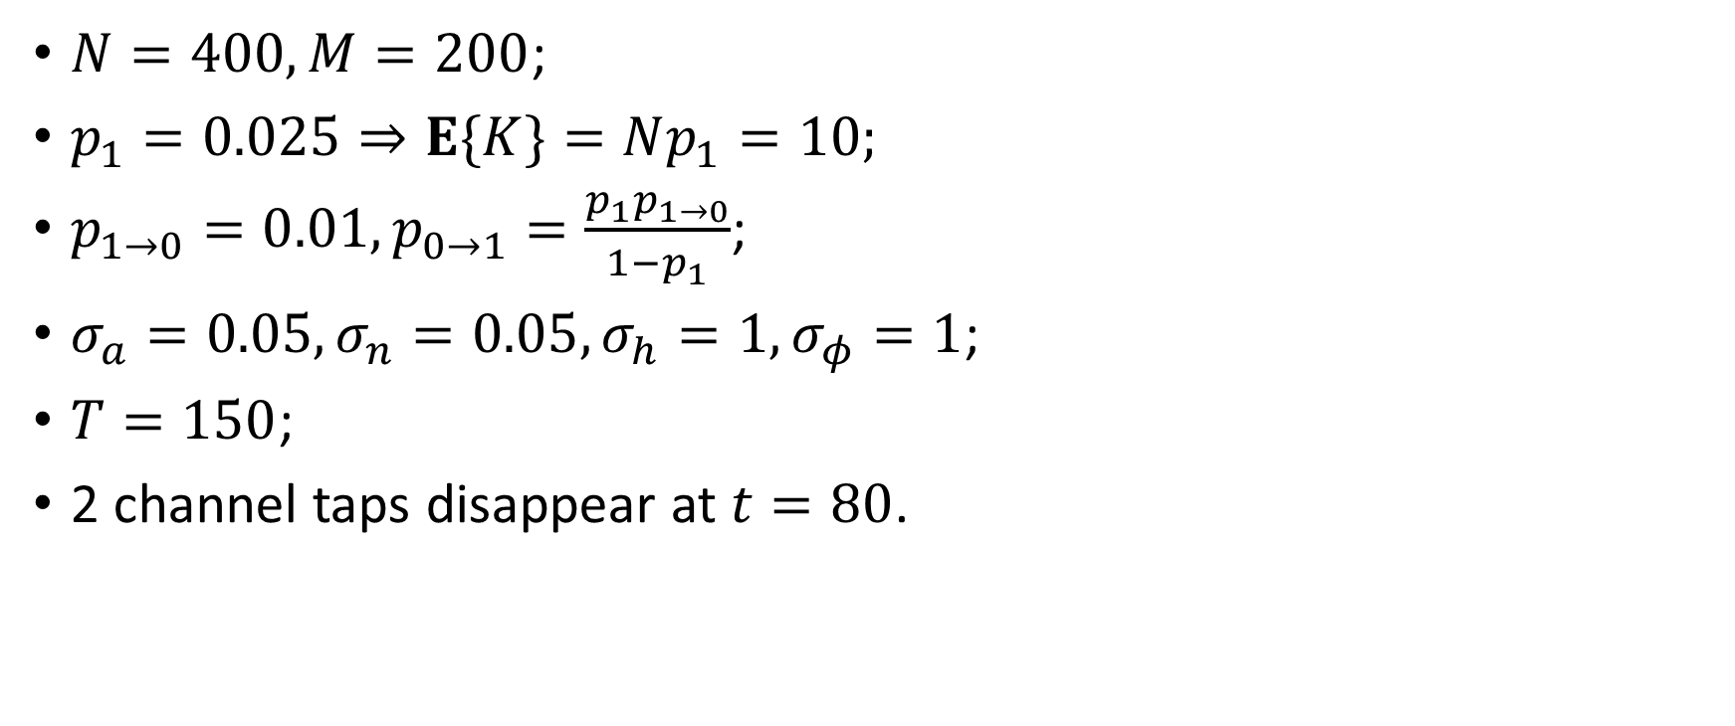
Simulation Setting
$N=400, M=200$;
$p_{1}=0.025⇒E\{K\}=Np_{1}=10;$
$p_{1→0}=0.01, p_{0→1}=\frac{p_{1}p_{1→0}}{1−p_{1}}$;
$σ_{a}=0.05, σ_{n}=0.05,σ_{h}=1, σ_{φ}=1$;
$T=150$;
2 channel taps disappear at $t=80$.
Notes:
This page addresses the simulation setting.
Just some parameters for system model, especially for the dynamical sparse channel.

Slide 9
Simulation result (1)
Fig2. MSE performance comparison against time slot t.
Notes:
Fig. 2 shows the mean squared error (MSE) performance against time slot t for the five channel estimation methods.
It is clear that A-SOMP and HB-Kalmam achieve lower error levels than the standard OMP algorithm, while the conventional linear method performs worst.
The MSE performance of the proposed D-OMP algorithm is the best, as the temporal correlations of the dynamic sparse channel are efficiently exploited.

Slide 10
Simulation result (2)
Fig. 3. The channel tap correct detection probability comparison against SNR.
Notes:
Fig. 3 shows the correct detection probability of a persistent channel tap against SNR.
It is evident that the hard threshold used in many CS-based channel estimation methods is not adapted to the SNR.
In this paper, we proposed threshold P_th based on noise statistics, the correct detection probability can
be improved further.

Slide 11
Simulation result (3)
Fig. 4. MSE performance comparison against SNR.
Notes:
Fig. 4 shows the MSE performance comparison against SNR for the five channel estimation methods.
It is clear that the standard OMP algorithm outperforms the linear method by about 1 dB, where the benefit comes from utilizing the channel sparsity.
Further, A-SOMP and HB-Kalman are better than the standard OMP algorithm by about 2 dB, since they
partially consider the temporal correlations of the dynamic sparse channel.
For the proposed D-OMP algorithm, it is evident that another 2 dB SNR gain can be achieved due to
its capability to track the dynamic sparse channel rapidly.

Slide 12
Thank you~
Notes:
Thank you~
Actually, I am not so clear about this threshold since I am not the author.
If you any question about this paper, you can send e-mail to the authors for more information.

